Slide 1


Song Recommender System
Dipika Sharma

Slide 2

Song Recommender System
Recommend songs to user based on their listening history.
Using the Spotify dataset available at Kaggle.

Slide 3
Goal
Make users familiar with some new songs and album.
Improve user experience
Help business owners to grow their organization.
Notes:
Song recommender system will go through the user’s history and create a list of songs as per their preferences. The intend of this system is to make users familiar with some new songs and album to improve user experience. This system will help business owners to grow their income as this system will encourage users to make more purchases by recommending music tracks based on their earlier purchase.

Slide 4
Dataset: Source
Kaggle dataset.
Collected from Spotify – largest music streaming service provider.

Slide 5
Dataset features
This dataset is good for our purpose as it consists of user’s id and the purchases the users made in past.
Also consists of some scientific information about the songs like valence, acoustic Ness, and others.
The database contains 19 columns and 586672 rows.

Slide 6
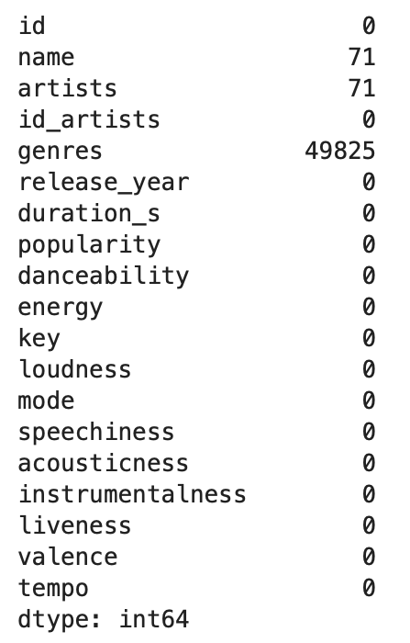
Data Understanding
Missing Values: Dataset consist of null values. To resolve this, we will be removing the rows with null values.
Duplicate Values: dropping the duplicate values for accuracy.
Notes:
The missing values and duplicate values can impact the result accuracy and reliability hence it is very important to handle them carefully in preprocessing step.
we can clearly stat that column genres have 49825 rows with missing values. This is the most important feature, which will be used in song recommender system to recommend the songs to the users and hence it need to be treated. For resolving the missing values issues I am removing the 50,000 rows from our dataset. Our dataset has more than 500K rows and removing 50K rows will not impact the dataset.
We also noticed using the nunique() function that the dataset has some duplicate values. It is important to remove the duplicate values from the dataset before creating the system. In order to do that we drop the duplicates rows from the dataset using the drop_duplicate() function.

Slide 7
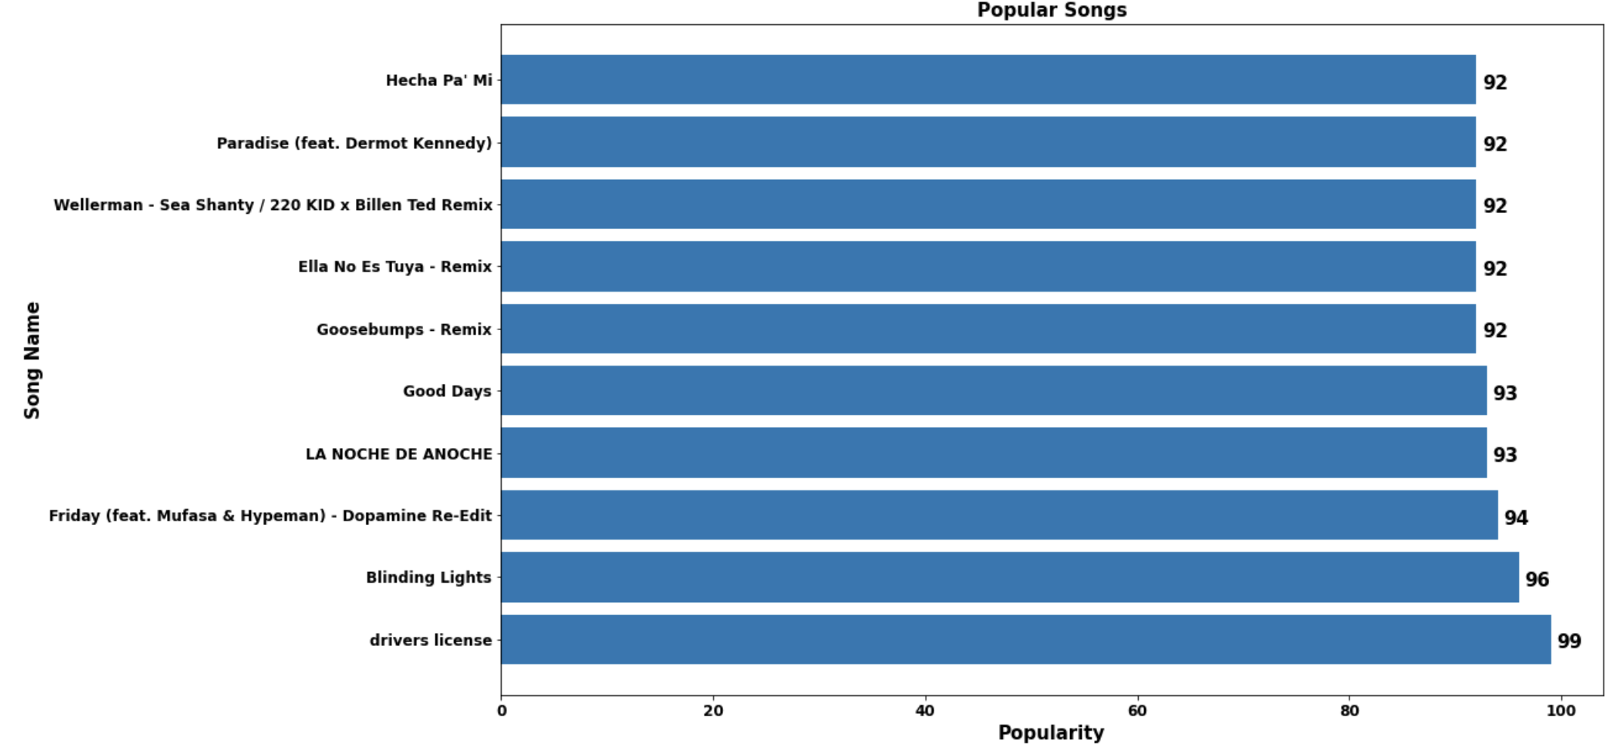
Most Popular Songs
Most popular song is “driver license”.
The popularity measure is 99 for most popular song
Notes:
I started the project work with exploratory data analysis as this will help me understand the data. I used different visualization to draw some initial conclusion.
As first visualization I analyze the top 10 most popular songs based on its popularity.

Slide 8
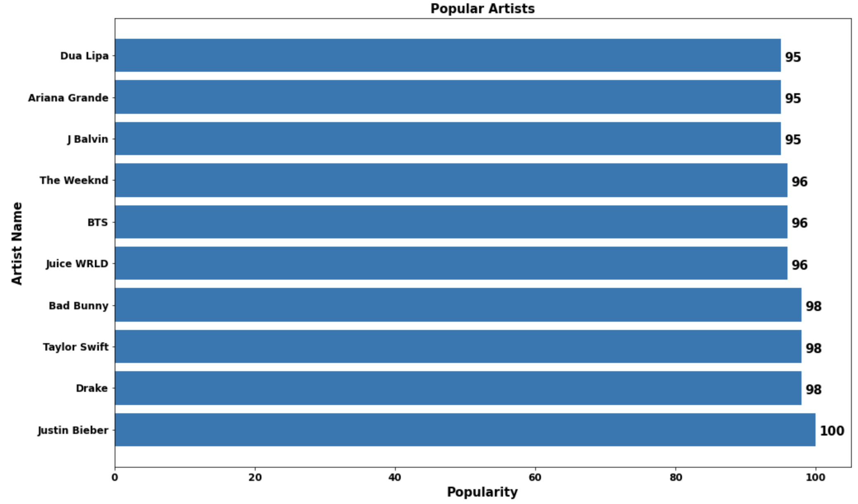

Popular Artists
Justin Bieber is most popular artist with 100 popularity measure.
Drake, Taylor Swift and Bad Money have same popularity measure of 98.

Slide 9
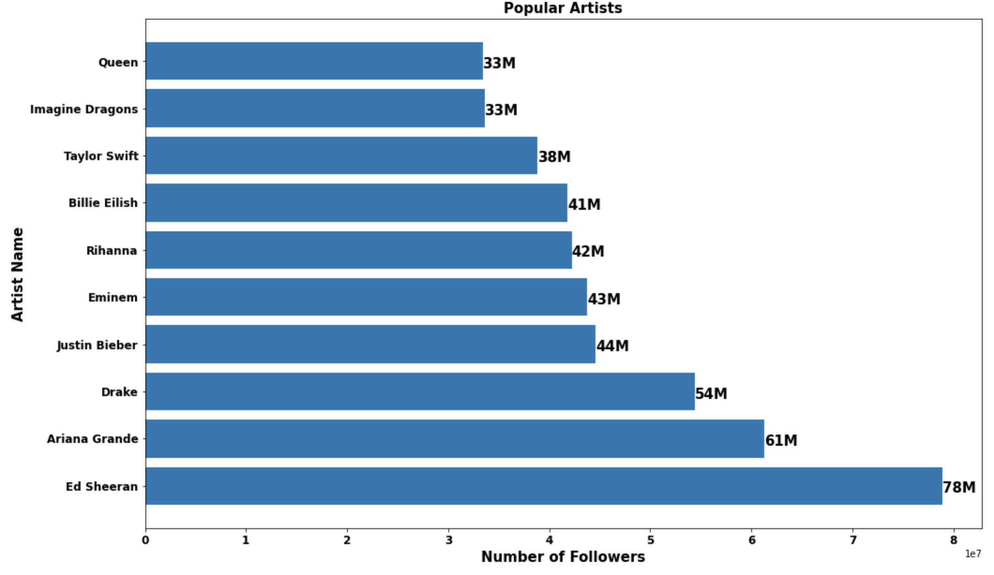

Popular Artists based on Followers
Ed Sheeran is most popular with 78M followers.
Ariana Grade is second popular with 61M followers
Drake is at third position with 54M followers.

Slide 10
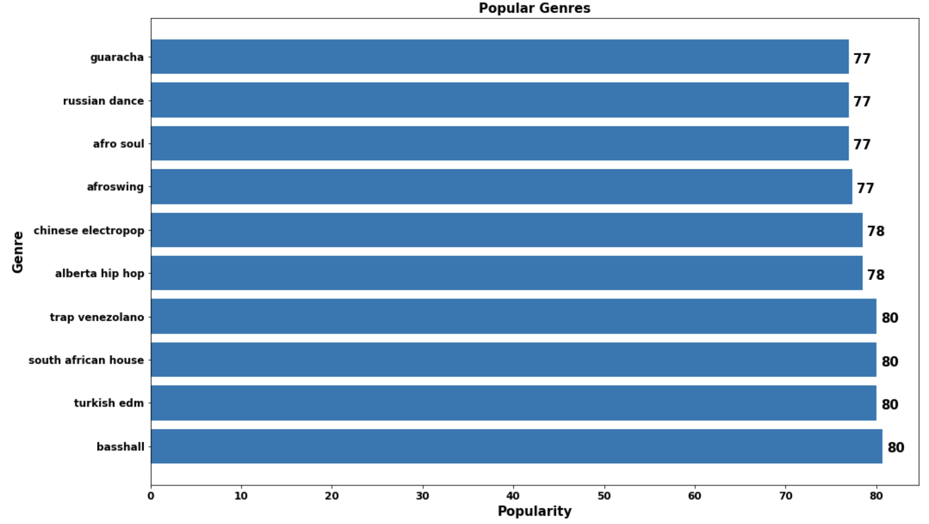
Popular Genres
Basshall genre is most popular.
Turkish edm, south African house and trap venezolano is also popular with same popularity measure 80.
Notes:
It is also important to know about the genres, so I analyzed the topmost genres based on the popularity measure.
As we can see The genre with maximum popularity is basshall.

Slide 11
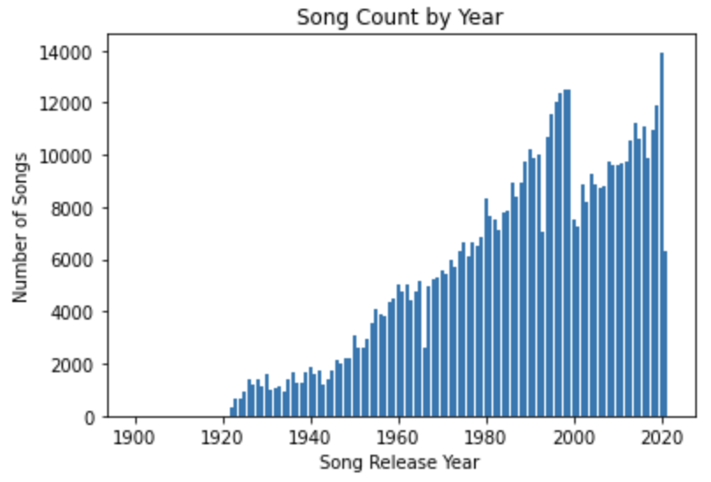
Songs Release By Years
Constant increase in number of songs released per year.
Most songs released during 2020 and in 1990.
Notes:
I also analyzed the number of songs per year to understand how many songs release per year.
As we can see the count of the songs is constantly increasing per year, the most songs were created in year 2020 and in year 1990. This visualization shows the successful years in the music industry.

Slide 12
Methodology:Algorithm
Consin Similarity
Compare the two vectors to find out the similarity.
Consider the relative presence or absence of musical attributes and prioritizes the similarity in sounds of the songs .
Resulting in good recommendation.
Notes:
As mentioned, the objective of the project is to create a song recommender system to recommend songs to the user as per their past choices. A classic approach is to perform the analysis on tracks database which consisted of various song features and artist information and take help of music expertise to recommend the songs, but a more modern approach includes machine learning. I am using the cosine similarity. This approach is considered to be the best if we need to compare the two vectors to find out the similarity and to understand the relationship between the two-vector considering the relative presence or absence of musical attributes and prioritizes the similarity in sounds of the songs resulting in good recommendation This is appropriate approach to deal with tracks data and most widely known for efficiency, reliability, and capability when we need to build recommender system.

Slide 13
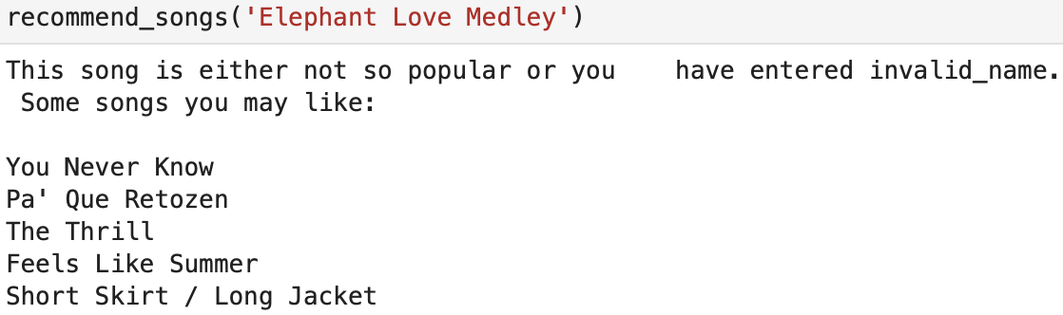
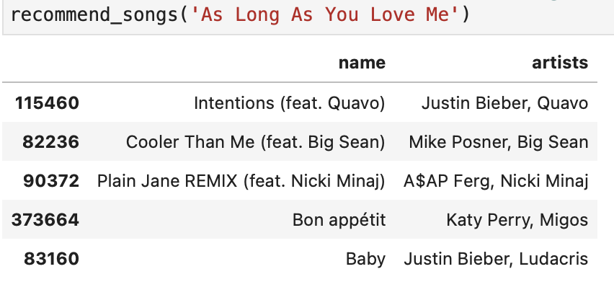
Methodology Results
System is built using the cosine similarity.
Input is song.
Model will compare the input song with dataset to find out the similarity.
Recommend top 5 similar songs
Notes:
The system is built using the cosine similarity, this system will take the input as song name and compared the two vectors – the input song compares the similarities with existing dataset songs features and will recommend the top 5 songs. As we can see The built system is tested and is working as it recommended the songs based on the input song.

Slide 14
Conclusion
Built model is working.
Results are encouraging.
Currently model is recommending the 5 top similar songs.
Further Research and Implementation
Notes:
To make our system better we can add collaborative filtering in our content-based system. In existing system, we are trying to recommend songs based on the genres and other features that are similar to the user past choice songs genres. With collaborative filtering we can recommend the songs based on the other users with similar tastes
This method will allow us to provide more personalized recommendation to the users.

Slide 15
Sources:
Data Source : - https://www.kaggle.com/datasets/subho117/music-recommendation-system-using-machine-learning/data

